Slide 1

5 cool scientific inventions
By Anirudh Vempati

Slide 2

Hello

Slide 3

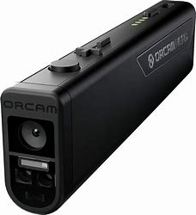
OrCam Read

Slide 4
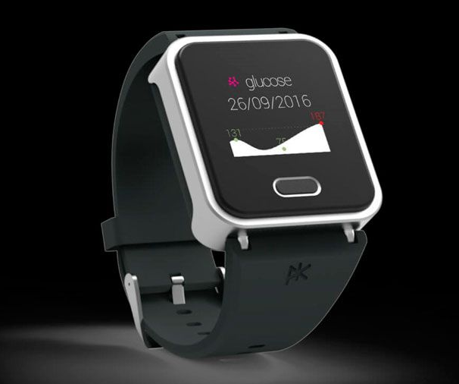
K’Watch Glucose

Slide 5

Bionic Eye

Slide 6

LLaMA

Slide 7
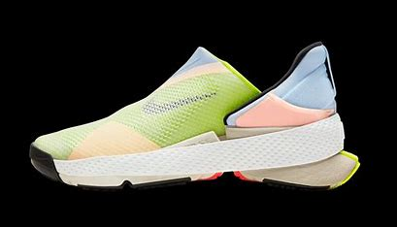
Nike Go FlyEase

Slide 8
Thank You

